Slide 1

Washington Association of Sheriffs and Police Chiefs
March 11, 2014

Slide 2
Today:
    Introductions
    STATIC 99
    Theory and big picture review
    Scoring tutorial
    Scoring practice

Slide 3
Static -99
An actuarial tool used for the prediction of sexual and violent recidivism among adult male offenders.
Tool was designed by Carl Hansen and David Thornton in 1999.
Combined 2 risk assessment tools, the RRASOR and the SACJ-Min.

Slide 4
Static Risk Factors
Do not change
Allows the long term level of risk for sexual recidivism
Allows determination of appropriate level of supervision and management for the individual (Andrews & Bonta, 2006)

Slide 5
Strengths
Uses valid risk factors associated with sexual recidivism
Gives explicit rules for combining these factors into a total risk score
Provides explicit probability estimates of sexual reconviction
Robustly predictive across several settings using a variety of samples
Easily scored

Slide 6
Weaknesses
Only moderate predicative accuracy
  We can always do better
  Coding rules can be confusing
  Must follow the rules
Neglects important factors
  Sexual deviance (phallometrics)
  All dynamic factors

Slide 7
Appropriate populations
Adult male sexual offenders
  18 years or older at time of release
  Arrested, Charged or Convicted for an offense that is known to have a sexual component or motivation
Victims
  Children
  Non consenting adults
Recent sex offense conviction or release

Slide 8
Validation
Validation means to test an actuarial instrument on different samples of sexual offenders to see if it works as well as on the developmental sample.
Static-99: 64 validations on over 20,000 sex offenders
    National and international samples
    Corrections, parole, probation, pre-trial forensic/psychiatric evaluations, prison/out-patient treatment programs, civil commitment, designated dangerous offenders

Slide 9
Static-99 / Static-99R
Most widely used instrument
Recently revised with new age item and new norms
Originally developed on 677 Canadian offenders and validated on 531 UK prisoners
New age item developed on 5,736 offenders, validated on 2,392

Slide 10


Slide 11
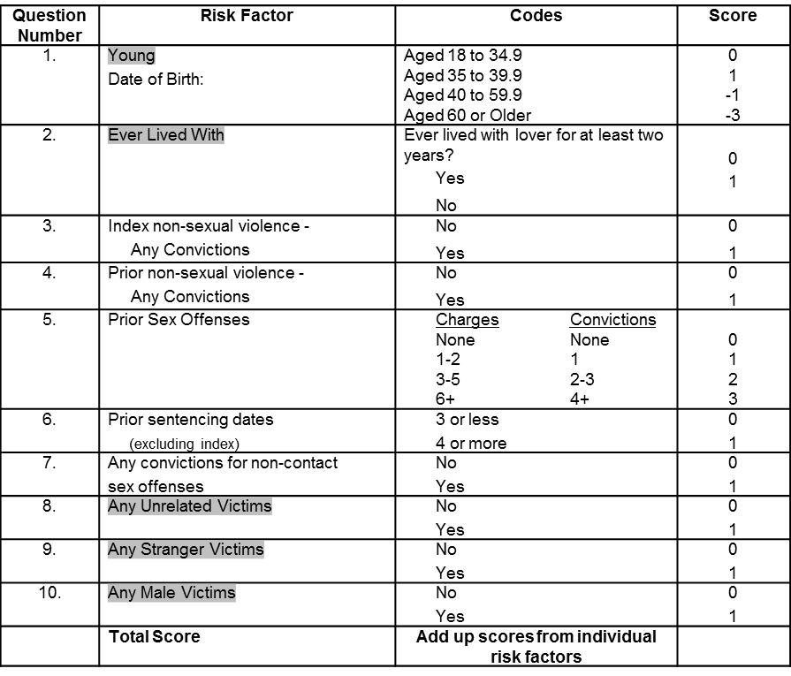
 |  | STATIC-99R CODING FORM
Name | DOC Number | Date
 | TRANSLATING STATIC 99 SCORES INTO NOTIFICATION LEVELS: | Score | Level
 |  | -3 to 3 | I
 |  | 4 to 5 | II
 |  | 6+ | III

Slide 12
STATIC-99R Revised Age Weights
Similar to other crime types, sexual offending tends to decrease steadily with age.
Research with additional samples was undertaken to further examine the contribution of age at release in the prediction of sexual recidivism, resulting in the development of new age weights.
Conclusion: Original Static-99 didn’t fully account for age at release and the new age weighting had greater predictive accuracy.
Static-99R sufficiently accounts for age in both rapist and child molester groups.

Slide 13
Static-99R
Age 18-60+
Ever lived with
Index non-sexual violence convictions
Prior non-sexual violence convictions
Prior sex offenses
Prior sentencing dates
Non-contact sex offense convictions
Unrelated victims
Stranger victims
Male victims

Slide 14


Slide 15
Item # 1 Young Coding Rules page 23
Basic Principle: Sex recidivism more likely in younger years than later years.
Information needed: Confirmed DOB
Basic Rule: Score -3 to 1 point depending on the age of offender at time of release for most recent sex offense.
  Between 18 and 34.99, score “1”
  35 to 39.9, score “0”
  40 to 59.9, score “-1”
  60 or older, score “-3”

Slide 16
Static-99R may be scored months before offender’s release to the community and may advance an age scoring category by the time he is released. For assessing risk in the future, consider age on the date of release (age at exposure to risk.)
Sometimes the release date may be uncertain (eligible for parole but no release plan). Can use conditional language indicating how risk assessment would change with a delayed release date.

Slide 17
Item # 2 Ever lived with CR page 25
Basic Principle: Research suggests having a prolonged intimate connection with someone may be a protective factor against sex offending – risk is lower with men who have been able to form intimate partnerships.
Information required: Confirmed relationship history – this is the only item that defaults in offender’s favor (scores “0” if history unknown.)
Basic rule: If offender has never had a significant, adult intimate relationship & lived together with a partner for 2 or more years score “1.”
.

Slide 18
Who can you have lived with…
Cohabitations of < 2 years do not count
Must be continuous, not “off and on”
Prison marriages/lovers do not count
Non-human species do not count
Priests/other celibates and juveniles – no exemption
Must be age of consent for relationship

Slide 19
Sexual vs. Non-sexual Violence CR page 13
Sexual offense
Sexual motivation
Name of the offense does not matter
Charges, convictions
Non-sexual violence
Motivation does not matter
  Sex or non-sex motivation counted
Name of the offense indicates violence but does not necessarily indicate sex
Convictions only

Slide 20
Sexual Offenses CR pages 14 & 15
Two types - Category A and B. If any “A” offenses then all “B” offenses count.
Category A
  Requires identifiable victim (child or non-consenting adult)
  Sexual assaults, including attempts
  Exhibitionism, voyeurism
  Manufacture/Create Child Pornography (offender must be present/participate in creation, with identified child victim)
  Kidnapping , homicide, and contributing to juvenile delinquency (where offenses have sexual element)

Slide 21
Sexual Offenses
Category B
  No identifiable victim
  Prostitution, pimping
  Child Pornography (possession, selling, transporting, creating where only pre-existing images are used)
  Indecency without sexual motive
    Urinating in public, public nudity associated with mental impairments
  Giving alcohol, drugs or noxious substances to victim with intent of making the offense easier
    May also score as Non-Sexual Violence
  Not informing sexual partner of HIV status

Slide 22
Index Sex Offense CR page 18
Most recent sex offense
  Conviction, charge, arrest, prison misconduct for sexual crime - EXCLUDING FAILURE TO REGISTER
May include multiple victims/offenses
Pseudo-recidivism counts as part of the index offense
  Did offender sexually reoffend after initial sex offense was detected
  Offender must be aware of detection

Slide 23
Index Cluster CR page 19
  A “spree” of offending prior to being detected or arrested that gets grouped together is considered an “Index Cluster.”
  There may be a number of sexual offenses in different jurisdictions over a protracted period, with sentencing dates in each jurisdiction, but the subsequent charges and convictions constitute an “Index Cluster.”
  Historical offenses that are detected after the offender is convicted of a more recent sexual offense (pseudo-recidivism) are considered part of the “Index Cluster.”

Slide 24
Pseudo-recidivism CR page 20
Occurs when an offender is currently involved in the criminal justice process and is charged with prior offenses for which they have never before been arrested/charged
  The offender hasn’t experienced a legal detection/consequence, been released, and then chosen to re-offend

Slide 25
Item #3 Index Non-sexual Violence CR page 27
Basic principle: History of violence is predictive of future violence.
Information required: Criminal history
Basic rule: If criminal history shows a separate conviction for non-sexual violent offense that was addressed on the same sentencing occasion as the Index Offense, score “1.”

Slide 26
Index Non-sexual Violence #3
Look at the Name of the Offense
Count only convictions
Victim can be the same as the victim for sexual offense or different
Be aware of pseudo-recidivistic violence – charge for prior or subsequent violence while incarcerated, as must be same sentencing occasion as Index
Includes convictions for Viol of DV Protection (Restraining Order)

Slide 27
Item #4 Prior Non-sexual violence
Basic principle: History of violence is predictive of future violence. Presence of non-sex violence predicts seriousness of damage were a re-offense to occur.
Information required: Criminal history
Basic Rule: If offender record shows a separate conviction for a non-sexual violent offense prior to the index arrest/charge/sentence date score “1.”

Slide 28
Prior Non-sexual Violence #4 CR page 31
Look at the Name of the Offense
Prior to index offense – Sanction imposed must have occurred prior to index offense being committed
Count only convictions
Victim can be the same as victim of the sexual offense or different

Slide 29
Non-sexual Violence #3 & #4
Includes convictions for aggravated assault, arson, forcible confinement, kidnapping, murder, robbery, threatening, and violation of DV protection order (restraining order).
Weapons offenses (i.e. Burglary 2nd Degree) would not count unless the weapon was specifically pointed at a victim during the commission of a violent or sexual offense.
If behavior was sexual but the offender was convicted of non-sexual violence, the same conviction counts as both a sexual offense and a non-sexual violent offense.

Slide 30
Non-sexual Violence #3 & #4
Do NOT Count:
Sexual assault/bodily harm, sexual assault with a weapon, aggravated sexual assault – score these as sexual offenses only
Driving accidents or negligence causing injury or death

Slide 31
Item #5 Prior Sex Offenses CR page 35
Basic Principle: Relates to criminal history and persistence of criminal activity. Criminal history is predictive of future offending.
Information needed: Criminal history
Basic Rule: Prior sex offense charges and convictions are summed separately; only behavior PRIOR to Index offense can be counted.

Slide 32
Prior Sex Offenses #5
Look at the behavior- Offense can be pled down and still count as a sex offense.
Exclude index offense(s)
Count all final charges and convictions (counts count, but are often plea bargained)
  If counts change (plea bargain) score only the final charges that go to court.
Sexual prison misconduct/infractions which could be charged as new offense can be scored as one “charge” (no conviction) per period of confinement.

Slide 33
Prior Sex Offenses #5
Prior parole or community supervision violations for sexual misbehavior count as one charge
    Multiple at the same time = one charge
    Separate occasions = one charge per incident
Acquittals - count as one charge
Not Guilty - count as one charge
Arrest only without charge/conviction for sexual offenses – count as one charge

Slide 34
Item #6 Prior Sentencing Dates
CR page 43
Basic Principle: Relates to criminal history and persistence.
Information required: Criminal history
Basic Rule: If offender record shows 4 or more separate sentencing dates prior to Index offense, score “1.” If offender record indicates 3 or fewer separate sentencing dates prior to index offense, score “0.”

Slide 35
Prior Sentencing Dates #6
An appearance in court where the offender receives a sentence for a crime or cluster of crimes
The crime must be sufficiently serious that incarceration or community supervision are possible sentencing options, even if the actual punishment is minor (i.e. fines, conditional sentence)

Slide 36
Prior Sentencing Dates #6
COUNT:
Finding of “not criminally responsible”
Juvenile offenses
Movement to a more secure placement as the result of a sexual or violent incident (i.e. WSH/ESH wards)
Parole board extends incarceration for a criminal offense – must extend total sentence
Military court martial judgments for criminal behavior that include a sanction (i.e.: dishonorable discharge)
  Do Not Count purely military charges such as failure of duty or not following an order.
e

Slide 37
Prior sentencing dates #6
Offenders on conditional release supervision returned to custody (i.e. Determinate Plus “Community Custody Board” revocations)
  Requires charge for new criminal offense or certainty that they would be charged with a new criminal offense in order to count
  Do Not Count returns to custody based on technical violations alone.
Suspended sentences (i.e. SSOSA/SSODA)
  Use original sentence date, and if revoked use revocation date. Do not “double up” - if Index is a revoked SSOSA based on technical violation behavior (not attending, not paying, etc.) Do Not Count the original suspended sentence date as a prior.

Slide 38
Prior Sentencing Dates #6
DO NOT COUNT:
Index or post Index offenses
Historical offenses (pseudo-recidivism)
Sentence overturned on appeal
Not guilty finding
Charges, acquittals, stayed offenses
Driving offenses unless associated with serious penalties (i.e. DUI or Reckless Driving Causing Death or Injury)
Misconduct or violations where fine is only possible sanction
Failure to Appear (only count the actual sentence when received)

Slide 39
Item #7 Non-contact Sex Offense
CR page 46
Basic Principle: Offenders with paraphilic interest are at increased risk for sexual recidivism.
Information required: Criminal history
Basic rule: If criminal history record indicates a separate conviction for a non-contact sex offense score “1.”

Slide 40
Non-contact Sex Offense #7
Look at behavior – not the offense title
Only count convictions
Typically exhibitionism, voyeurism, possession of child porn, and using the internet for sexual purposes
  Do Not Count attempted contact offenses, as these get counted as “contact offenses” based on intent
  Do not count soliciting/prostitution

Slide 41
Non-contact Sex Offense #7
Can be index or prior offense
“Criminal trespass” may count as voyeurism – need offense details
“Disorderly Conduct” for “ mooning” might count - you must consider the motivation
Plea Bargains – If pled down from a contact offense treat as a contact offense (most common = Communication with Minor for Immoral Purposes)

Slide 42
Items #8, #9, & #10 CR page 48
The Three Victim Questions
Requires direct sex offense victim
  Alive or deceased
Requires intent to offend against a particular person – Do Not Count “Accidental” victims
  Citizens who happen upon offense
  Officers or workers in performance of their duties
  Others present during offense
Do Not Count animals as victims

Slide 43
The Three Victim Questions
Items #8, #9, & #10
Do Not Count convictions where there is no identifiable victim or offenses that are “consensual” but prohibited by statute = category “B” type offenses.
  Statutory rape cases where the contact was consensual in nature
  Prison infraction for sexual acts with consensual peer
Child Pornography - only identifiable, “live” children selected by the offender to create pornographic images can be counted as victims

Slide 44
The Three Victim Questions
Items #8, #9, & #10
Exhibitionism
  If mixed group, assume only females unless there is evidence males were targeted.
  Do Not Count witnesses to psychotic street person misbehaviors (i.e. “showering” nude in a public fountain).
Voyeurism
  Even if male is in the home, assume female victim unless there is evidence to believe offender targeted/watched the male.
Victim Not at Home –
  If offender breaks into a home to steal undergarments, assume female victim unless there is evidence that a male was targeted.

Slide 45
The Three Victim Questions
Items #8, #9, & #10
The offenders’ perception of the victim is important
  Transvestite - if the offender thought the victim was a female score as a female.
  Internet Stings – if the offender thinks he is communicating with a 13 yr old boy and asks for nude photos to be sent, score male victim even if it is a female police officer. There is an intended, identifiable “victim.”

Slide 46
The Three Victim Questions
Items # 8, # 9, & #10
Polygraph information was not included in original scoring of the STATIC 99
  Never use polygraph information alone to score
  Information obtained through polygraph that is corroborated can be used to score victim questions

Slide 47
Item #8 Any Unrelated Victims CR page 52
Basic principle: Research indicates offenders who offend only against family members recidivate at a lower rate than those who have victims outside immediate family
Information needed: Credible information
Basic rule: If the offender has victims of sex offenses outside their immediate family score “1.”

Slide 48
Any Unrelated Victims #8
Spouses are related
  Consider whether too close to marry?
Step relatives, “common law,” and lovers require 2 or more years of residing together to count as related
  Consider the nature of the pre- offense relationship
Becoming Unrelated
  Biological relatives may count as unrelated victims if offender didn’t know he was offending against a family member (i.e. offender given up for adoption or removed from home at birth).

Slide 49
Any Unrelated Victims #8
Unrelated:
Step relations where the relationship has lasted less than two years before offending begins.
Daughter/son of lover unless they have lived with offender 2 or more years before offending begins.
Nephew’s wife
Second cousins
Wife’s aunt
*If in doubt consider the psychological relationship prior to the assault. Offender must have a “family” type relationship of at least 2 years duration.

Slide 50
Item #9 Any Stranger Victims CR page 54
Basic Principle: Having a stranger victim is related to higher recidivism
Information required: Credible information
Basic Rule: If offender has victims of sex offenses who were strangers at the time of the offense score “1.”
If victim of sex offense was known to the offender for at least 24 hours prior to the offense, score “0.”
*Stranger victim also scores as unrelated.

Slide 51
Any Stranger Victim #9
It does not take much to be “known” and therefore not a stranger – but it does take some interaction.
  A store clerk who has sold the offender cigarettes on 3-4 occasions and has greeted or spoken with him slightly is not a stranger.
  A woman who stocks the shelves and has seen the offender 3-4 times but never spoken to him is a stranger.

Slide 52
Any Stranger Victim #9
Internet, telephone and email - the “24 hour rule” applies
  If the victim and offender make 1st contact at 8 pm Wednesday the offense must happen by 8 pm on Thursday
  If they chat back and forth for more than 24 hours they are no longer strangers
Becoming a stranger
  Victim has forgotten offender completely (over years)
  Offender thinks he is assaulting a complete stranger

Slide 53
Item #10 Any Male Victims CR page 56
Basic principle: Research shows that offenders with male victim(s) recidivate at a higher rate compared to those offenders without male victims.
Information required: Credible information
Basic rule: If the offender has minor male or non-consenting adult male sex offense victim score “1.”

Slide 54
Any Male Victims #10
Consider the Intent
  If offender makes a male watch or forces him to take part in a sexual offense, there is a male victim.
  If the behavior was to confine the male (i.e.: tied up in closet or corner during sexual assault of male’s wife) Do Not Count male victim.

Slide 55
End of Sentence Review Committee Baseline Classification
STATIC 99R Score
-3 to 3
4-5
6+
Risk Classification
Risk level I
Risk level II
Risk level III

Slide 56
Departure Considerations:
Aggravating Factors
Statements of intent/threat to sexually re-offend
Past interventions and/or treatment have not deterred sexually deviant behavior
Pattern of behavior that increases risk for sexual re-offense
  Inability to control impulses
  Repeated pattern of placing self in high risk situations and/or locations in order to gain access to individuals of similar age/circumstances as prior sex offense victims

Slide 57
Departure Considerations:
Aggravating Factors
Documented information that increases risk for sexual re-offense
Relationship with sex offense victim(s) was established or promoted for the primary purpose of victimization
Offender used a position of community trust (e.g. coach, teacher, clergy, etc.) to gain access to sex offense victim(s)

Slide 58
Departure Considerations:
Mitigating Factors:
Offender age
Familial or known sex offense victim(s)
Current offense is not sexual in nature
Previously classified as Risk Level 1
24 hour supervised placement (juvenile)
Disability or terminal illness that decreases ability to sexually re-offend
Non-contact sex offense (e.g. possession of pornography)
Sexual offending appears opportunistic in nature

Slide 59
Years Offense Free in Community
When considering if offenders are able to remain in community 2 – 10 years without another serious offense, their chances of sexual recidivism decreases substantially
Offense free
  No new sexual or non-sexual offenses
  No offenses that result in long incarcerations

Slide 60
Minnesota Sex Offender Screening Tool – Revised (MnSOST-R)
Different population
Different rules
Dynamic factors
Used with incarcerated population
Determination for SVP referrals in MN – WA has specific criteria outlined in statute for civil commitment

Slide 61
Kim Acker
DOC Civil Commitment Program Administrator
(253) 983-7159
kmacker@doc1.wa.gov

